Slide 1
Software Design & Architecture
Week 02
Abeeha Sattar

Slide 2
Types of Feedback
Feedback from early development/client demos
To refine requirements
Feedback from tests and developers
To refine design and models
Feedback from the progress of the team
To refine schedules and estimates
Feedback from the client and the marketplace
To re-prioritize features for next iteration

Slide 3
Iterative & Evolutionary Analysis & Design – Example

Slide 4
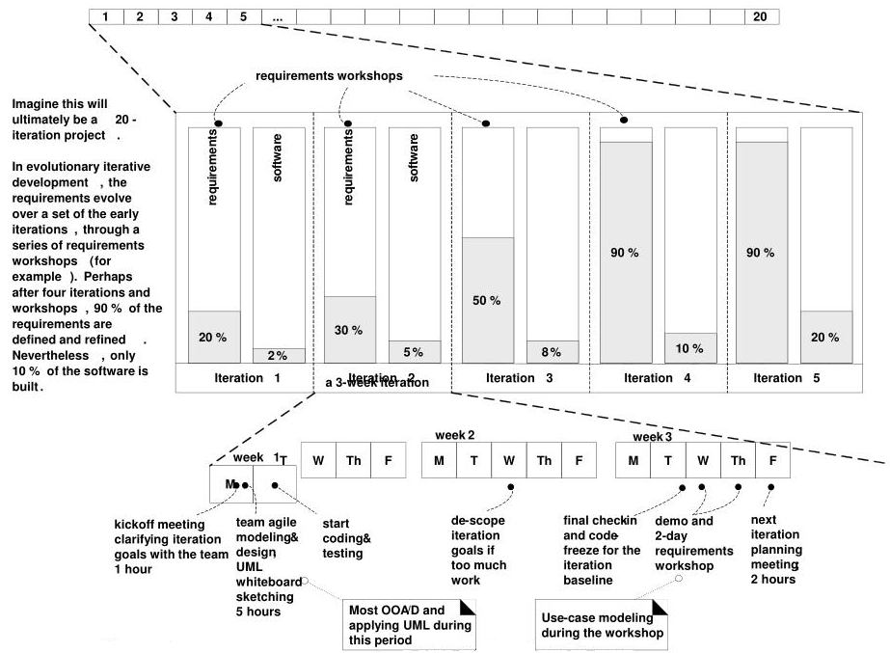

Slide 5
The Unified Process

Slide 6
The Unified Process (UP)
A standardized approach to analysis and design helps to ensure that all necessary tasks are understood and completed in software development.
Requiments analysis and OOAD needs to be presented and practiced in the context of some development process.
An agile approach to well-known UP is used as an iterative development

Slide 7
The Unified Process (UP)
A software development process describes an approach to building, deploying, and maintaining software.
UP has emerged as a popular and effective iterative software development process for building OO systems.
Rational Unified Process (RUP) is a modified version of the Unified Process, which was modified by Rational Software, is widely practiced and adopted by our industry.

Slide 8
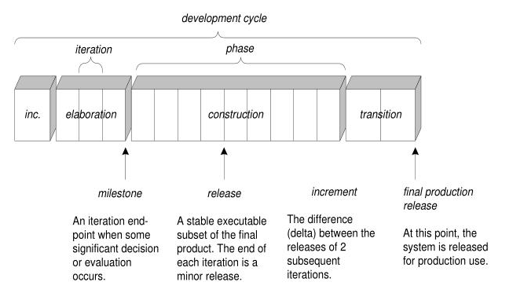
The UP Phases

Slide 9
Risk-Driven Planning
Identify and drive down the highest risks
Includes the practice of architecture-centric iterative development. i.e., early iterations focus on building, testing and stabilizing the core architecture.
Tackles the difficult things first

Slide 10
Client-Driven Programming
Builds visible features that the client cares most about.

Slide 11
Advantages of UP
Emphasis on addressing very early high risk areas.
It does not assume a fixed set of requirements at the inception of the project, but allows to refine the requirements as the project evolves.
It does not put a strong focus on documents.
The main focus is the software product and its quality.

Slide 12
Agile UP
Prefer a small set of UP activities and artifacts
Requirements and designs are not completed before implementation. They adaptively emerge through a series of iteration, based on feedback
Apply the UML with the agile modeling principles
There is no detailed plan for the entire project
There is a high-level plan (called the Phase Plan) that estimates the project and end date and other major milestones. But, it does not detail the fine grained steps to those milestones
A detailed plan (called the Iteration Plan) only plans with greater detail one iteration in advance. Detailed planning is done adaptively from iteration to iteration

Slide 13
UP Best Practices
Get high risk and high value first
Constant user feedback and engagement
Early cohesive core architecture
Test early, often and realistically
Apply use cases where needed
Do some visual modeling with UML
Manage requirements and scope creep
Manage change requests and configuration

Slide 14
UP Phases
Inception
Approximate vision, business case, scope, vague estimates.
Note: Inception is not a requirements phase; rather, it is a kind of feasibility phase, where just enough investigation is done to support a decision to continue or stop.

Slide 15
UP Phases
Elaboration
Refined vision, iterative implementation of the core architec ture, resolution of high risks, identification of most requirements and scope, more realistic estimates
Note: Elaboration is not the requirements or design phase; rather, it is a phase where the core architecture is iteratively implemented, and high risk issues are mitigated.

Slide 16
UP Phases
Construction
Iterative implementation of the remaining lower risk and easier elements, and preparation for deployment.
Note: Construction is not the implementation phase

Slide 17
UP Phases
Transition
Beta tests, deployment

Slide 18
Fin.

